Slide 1
Leadership skills

Slide 2
Scenario
You are paged to a rapid response on a patient who is on the cardiology service. Upon arriving you introduce yourself to the bedside nurse as the rapid team leader and start to get some of the story.
You learn that the patient is admitted for new afib w/ RVR. He had previously been stable with rates in the 120s but over the last 30 minutes his rates have climbed to the 180s and his blood pressure has dropped from 120 to 90 systolic. While talking with the nurse you notice that there are at least three other people with “Doctor” on their badge standing in the room but none of them approach you or introduce themselves.
Notes:
[ ] streamline to bullet points and simplify – ethan to help
[ ] add quiz element – ie show ekg, decide what to do – I can build this into website.
We like the rapid response pivot here because they are more ambiguous
How do you respond?
What do you do if the primary team comes?
What do you do if the ICU team comes?

Slide 3
Scenario cont.
After getting the story and examining the patient, you decide to administer IV metoprolol to try and slow his heart rate. You inform the bedside RN of your plan and then go to talk with the patient’s family to give them updates on the situation.
After five minutes you notice that the patient has become severely bradycardic and his hypotension is worsening. You administer atropine without improvement and end up having to transcutaneously pace him to increase his heart rate. He eventually stabilizes and is transferred to the ICU.

Slide 4
Scenario cont.
While reviewing the case later you realize the patient was given three different doses of metoprolol instead of the one you verbally ordered. You call the bedside RN to discuss and she lets you know that two other doctors came up to her after you and also told her to give metoprolol so she gave three total doses. You find out that the other doctors were the primary team resident and cardiology fellow and both of them were unaware that you were at the rapid response at all.

Slide 5
What went wrong?
Notes:
Lots to discuss here. Obvious answer is the rapid resident should have introduced themself to the room rather than just bedside RN and asked if any of the present physicians were already running the code.
They should also invite fellow team members to share information and work collectively on the care plan. Engaging the primary team in decision making is incredibly valuable.

Slide 6
Effective Leadership SKills
Establish a clear leader
Collaborate and share information

Slide 7
1. Establish a clear leader: Are you running this code or not?
"I’m ________, the resident on the the Code/RR team. Is anyone running this code?"
Alternative:
“OK, I’m running this code” or “Can I take over?"
Notes:
If someone IS already running it – that’s OK. They often want to hand over. If they don’t, make yourself useful.
You just need to commit to saying this. Loudly, right when you enter the door.
Examples where this comes up

Slide 8
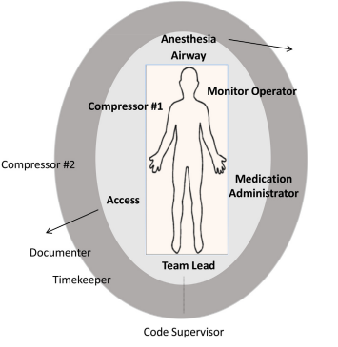
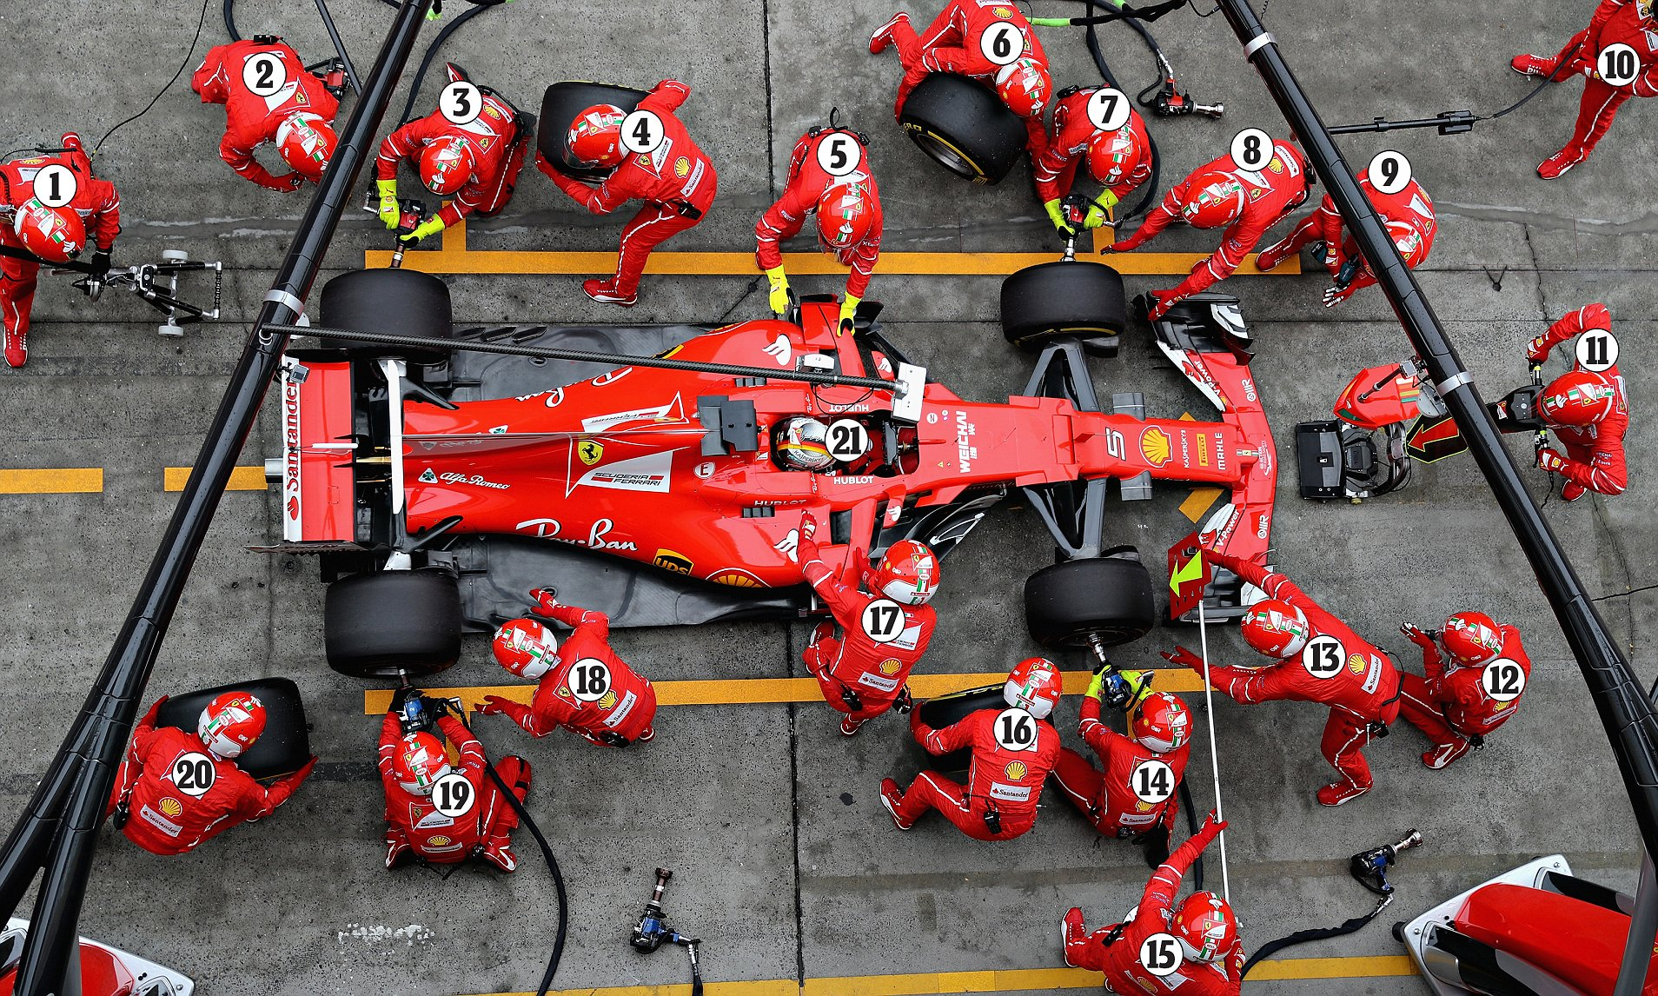
1. Establish a clear leader: Be the point person
https://doi.org/10.1016/j.resuscitation.2020.11.018
NEVER MOVE FROM HERE
DON’T DO IT
Notes:
I recommend foot over groin because it’s too tempting to do things at the groin
Closed Loop communication and delegation
Tell specific people to do specific things
Ask for closed loop communication.
Park yourself at the foot of the bed (do NOT do any tasks unless there are <4 people present)
feet in a power pose – power posing is bullshit and won’t change how you feel, but it will change how other people perceive you.
+/-ACLS card in front of you.
Direct traffic.
If someone asks for a task you agree with, say "Yes, <repeat it>" - all commands are coming from you.

Slide 9
2. Collaborate and share information: Invite suggestions by setting a constructive tone
Try this, not this …
- To establish leadership
To think out loud
We checked x,y,z.. Does anyone have thoughts?
To encourage open dialogue while maintaining leadership (conversation
Notes:
[We want to encourage actions rather than traits/characteristics]
Think out-loud (nobody’s perfect – enroll help)
- Give more encouragement than critique
Calm, collected, and in control
Modulate your voice; no yelling
Coach, don’t reprimand.
Give encouragement.
Lower the power difference
Some helpful phrases:
I’m going to summarize what I’m thinking…
Does anyone have any other ideas of things we might missing
“that’s a great point” …
Framework: goals that you want the team to perceive –
you’re open to input
You’re making unambiguous
- Folks understand your thinking
You can call for quiet to lower the noise level. Have folks step out if too crowded – you control the environment.
https://twitter.com/ross_prager/status/1769700101629399542?s=46&t=5eJ6uoTQrbbYTlHIOnRYRg – good thread with more detail and dope pixel art
What is the point of the bottom two?
Think of motivational interviewing with a patient.. You NEVER want to argue. You want to direct. Do the same thing here. You are directing a competent team of professionals who could do a pretty good job running a code on their own (they do in lots of places). Don’t break the machine – you want to productively guide it.
Fine V-Fib example. RN notices, but not empowered.

Slide 10
Scenario revisited
In an alternate universe, you are paged to the same rapid response – but this time you introduce yourself to the room on arrival and confirm with the primary team that they are happy to let you run the rapid. You stand at the head of the bed and collect information and suggestions from various team members.
The primary team resident suggests trying IV metoprolol x 1 to which you say “great idea”. After one dose of metoprolol the patients heart rate drops to ~120s and their blood pressure improves. They are transitioned to oral metoprolol and are able to stay on the floor without transferring to the ICU.
Notes:
Takeaway points:
Establish leadership
Think out loud
We checked x,y,z.. Does anyone have thoughts?
Encourage open dialogue while maintaining leadership (conversation

